Slide 1


Nutan Maharashtra Vidya Prasarak Mandal’s NUTAN COLLEGE OF ENGINEERING AND RESEARCH Under Administrative Support of Pimpri Chinchwad Education Trust ISO 21001:2018 EOMS Certified
Project Presentation
Presentation on
Robust Human Detection, Tracking & Counting
By
Aman Javed Maner (2164191913028)
Pratik Sarjerao Gade (2164191913030)
Under the guidance of
Prof. Priyanka Vyas
Department of Computer Science and Engineering
( Artificial Intelligence )

Slide 2
Nutan Maharashtra Vidya Prasarak Mandal’s NUTAN COLLEGE OF ENGINEERING AND RESEARCH Under Administrative Support of Pimpri Chinchwad Education Trust ISO 21001:2018 EOMS Certified
Project Presentation
Problem Statement :
Human detection using Deep learning especially YOLOv8 for detecting ,tracking , counting human targets
Objective :
Human detection and counting system using YOLO (You Only Look Once) version 8 for robust and efficient identification, tracking, and counting of human subjects in video streams .
Detecting Humans
Tracking Humans
Counting Humans

Slide 3
Nutan Maharashtra Vidya Prasarak Mandal’s NUTAN COLLEGE OF ENGINEERING AND RESEARCH Under Administrative Support of Pimpri Chinchwad Education Trust ISO 21001:2018 EOMS Certified
Project Presentation
Methodology :
Data Collection and Preprocessing:
- Collecting a diverse dataset of images and/or videos containing annotated humans
- Preprocess the data by resizing images, normalizing pixel values, and converting annotations into the YOLO format.
Model Selection and Training:
- Choose YOLO v8 as the base architecture for human pose detection.
- Initialize the model with pre-trained weights or train it from scratch on your dataset.
Object Detection:
- Utilize the trained YOLO v8 model to perform real-time object detection.
Tracking Mechanism:
- Implement a tracking algorithm (e.g., SORT or DeepSORT) to track individuals across consecutive frames in video streams.
Counting Mechanism:
Design a counting mechanism based on the tracked human instances.
Define counting criteria (e.g., entry into a specified region of interest) for accurate counting.

Slide 4
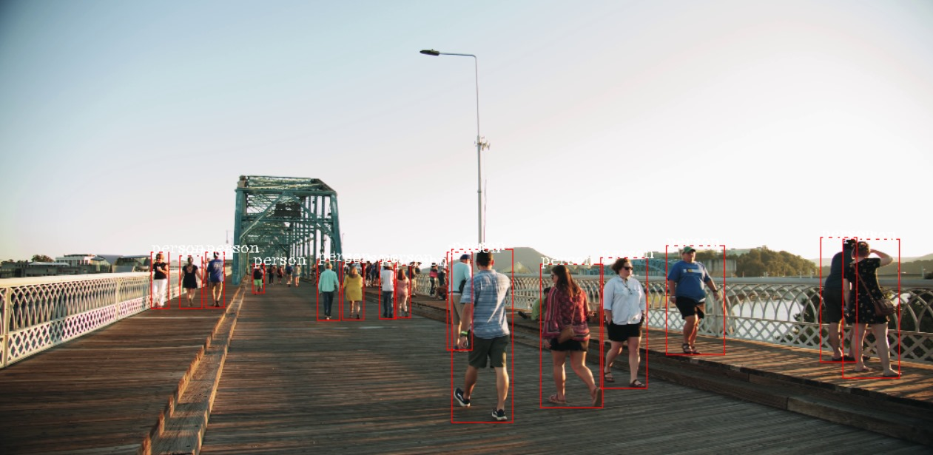
Nutan Maharashtra Vidya Prasarak Mandal’s NUTAN COLLEGE OF ENGINEERING AND RESEARCH Under Administrative Support of Pimpri Chinchwad Education Trust ISO 21001:2018 EOMS Certified
Project Presentation
Result :

Slide 5
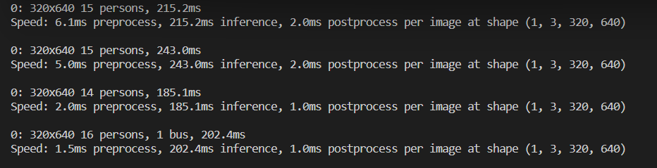
Nutan Maharashtra Vidya Prasarak Mandal’s NUTAN COLLEGE OF ENGINEERING AND RESEARCH Under Administrative Support of Pimpri Chinchwad Education Trust ISO 21001:2018 EOMS Certified
Seminar / Project Review / Project Presentation
Number of persons detected = 16
Object deteceted = 1 bus

Slide 6
Nutan Maharashtra Vidya Prasarak Mandal’s NUTAN COLLEGE OF ENGINEERING AND RESEARCH Under Administrative Support of Pimpri Chinchwad Education Trust ISO 21001:2018 EOMS Certified
Project Presentation
Future Scope :
- Human Behavior Analysis
- Collaboration with IoT
- Human Behavior Analysis
- Real-Time Alerts and Notifications
- Human Pose Estimation
- COD
Conculsion :
"In conclusion, the 'Robust Human Detection' mini project successfully leverages YOLO v8 and Deep SORT for real-time human detection, tracking, and counting. The integration of state-of-the-art algorithms ensures accurate and efficient monitoring, showcasing the project's potential for applications in surveillance, crowd management, and beyond."

Slide 7
Nutan Maharashtra Vidya Prasarak Mandal’s NUTAN COLLEGE OF ENGINEERING AND RESEARCH Under Administrative Support of Pimpri Chinchwad Education Trust ISO 21001:2018 EOMS Certified
Project Presentation
Literature Survey (Research Paper) :
[ Manikandaprabu NALLASIVAM, Vijayachitra SENNIAPPAN, ”Moving Human Target Detection and Tracking in Video Frames ”, Studies in Informatics and Control, ISSN 1220-1766, vol. 30(1), pp. 119-129, 2021. https://doi.org/10.24846/v30i1y202111]
[Hao Kong, Zhi Chen, Wenjing Yue, Kang Ni, "Improved YOLOv4 for Pedestrian Detection and Counting in UAV Images", Computational Intelligence and Neuroscience, vol. 2022, Article ID 6106853, 9 pages, 2022. https://doi.org/10.1155/2022/6106853 ]
[Mokayed, H., Quan, T. Z., Alkhaled, L., & Sivakumar, V. Real-Time Human Detection and Counting System Using Deep Learning Computer Vision Techniques. Artificial Intelligence and Applications , 2022 https://doi.org/10.47852/bonviewAIA2202391 ]
[Gündüz, M.Ş., Işık, G. A new YOLO-based method for real-time crowd detection from video and performance analysis of YOLO models. J Real-Time Image Proc 20, 5 (2023). https://doi.org/10.1007/s11554-023-01276-w ]

Slide 8
Nutan Maharashtra Vidya Prasarak Mandal’s NUTAN COLLEGE OF ENGINEERING AND RESEARCH Under Administrative Support of Pimpri Chinchwad Education Trust ISO 21001:2018 EOMS Certified
Seminar / Project Review / Project Presentation
Thank You

